Slide 1

Paradise
the
Inn.
resort
2023
Name : Patel Yatrik Nileshbhai
Class : C1
Roll Number : 21
Branch : CSD
Environmental Number : 2021002170310022

Slide 2
About paradise inn.
A resort website is an online platform that provides information about a specific resort . The website is designed to attract potential guests by showcasing the facilities, amenities, and services offered by the resort. It is also used to facilitate the booking process and provide useful information about the surrounding area, nearby attractions, and local events.
A resort website typically includes details about the types of accommodations available, such as rooms, suites, and villas, and their features and amenities. It may also feature information about dining options, spa services, fitness facilities, and recreational activities offered at the resort. The website often includes photos and videos of the resort and its surroundings to provide a visual representation of the experience that guests can expect.
Overall, a resort website plays an essential role in promoting the resort, attracting new guests, and providing a seamless booking experience for those interested in staying at the property.

Slide 3
Table of contents
01
HOME
02
ABOUT
03
ACTIVITES
04
GALLERY
PROVIDE OVERVIEW OF THE RESORT!
ABOUT PARADISE PHILOSOPHY AND CULTURE
FUN AND ADVENCTURORUS ACTIVITES LIST!
PHOTOS AND REVIEW OF ROOMS!

Slide 4
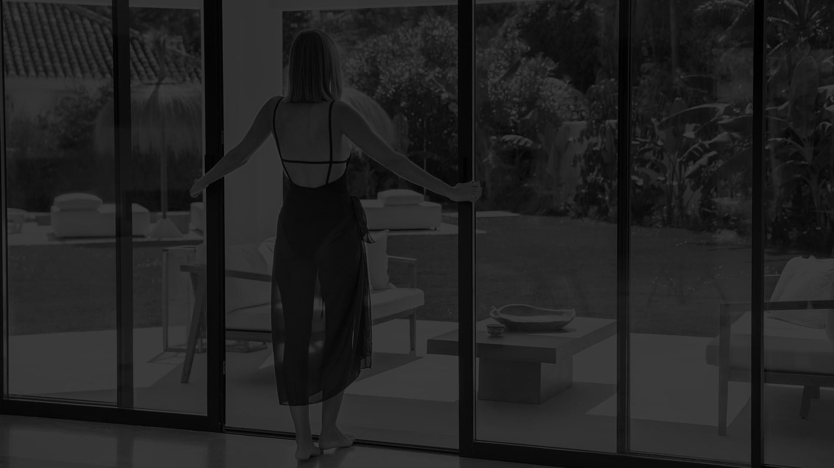
01
About the
paradise
About page consist of the main website body which holds mainly two things the carousel and contents

Slide 5

About
us
You can see the overview of room and overall resort through a carousel.
You can also read the paradise philosophy and the cultural events!

Slide 6
Paradise Philosophy
Sustainability, respect for local culture and
profound connection inform the paradise experience.
Embrace your sense of wonder and go within to feel
something unexpected, profound and new.
Discover the world and your place within it.
Explore new places and cultures with a
considered approach letting rare, intimate
experiences guide you through destinations
unknown.

Slide 7
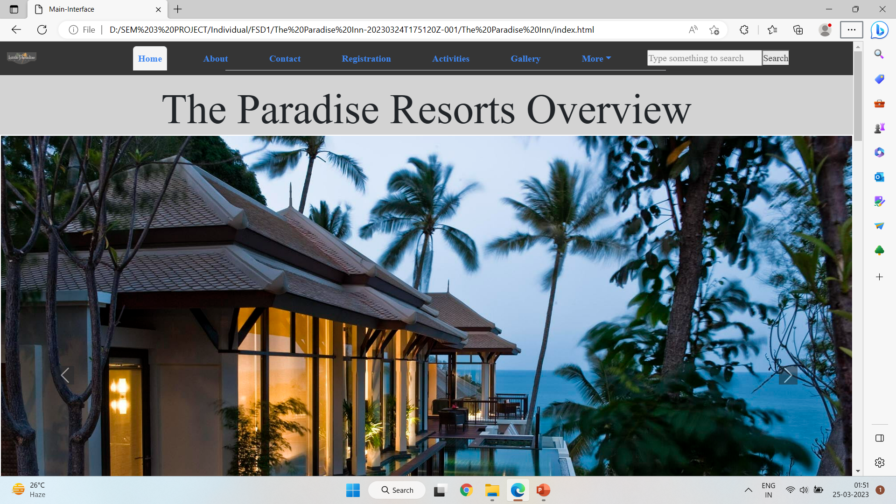
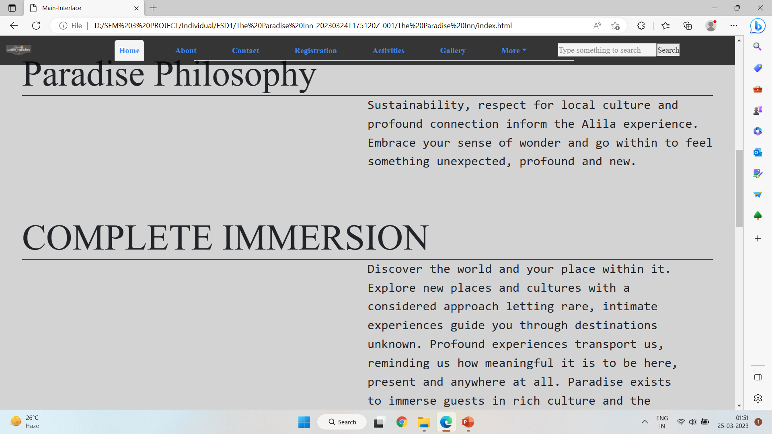
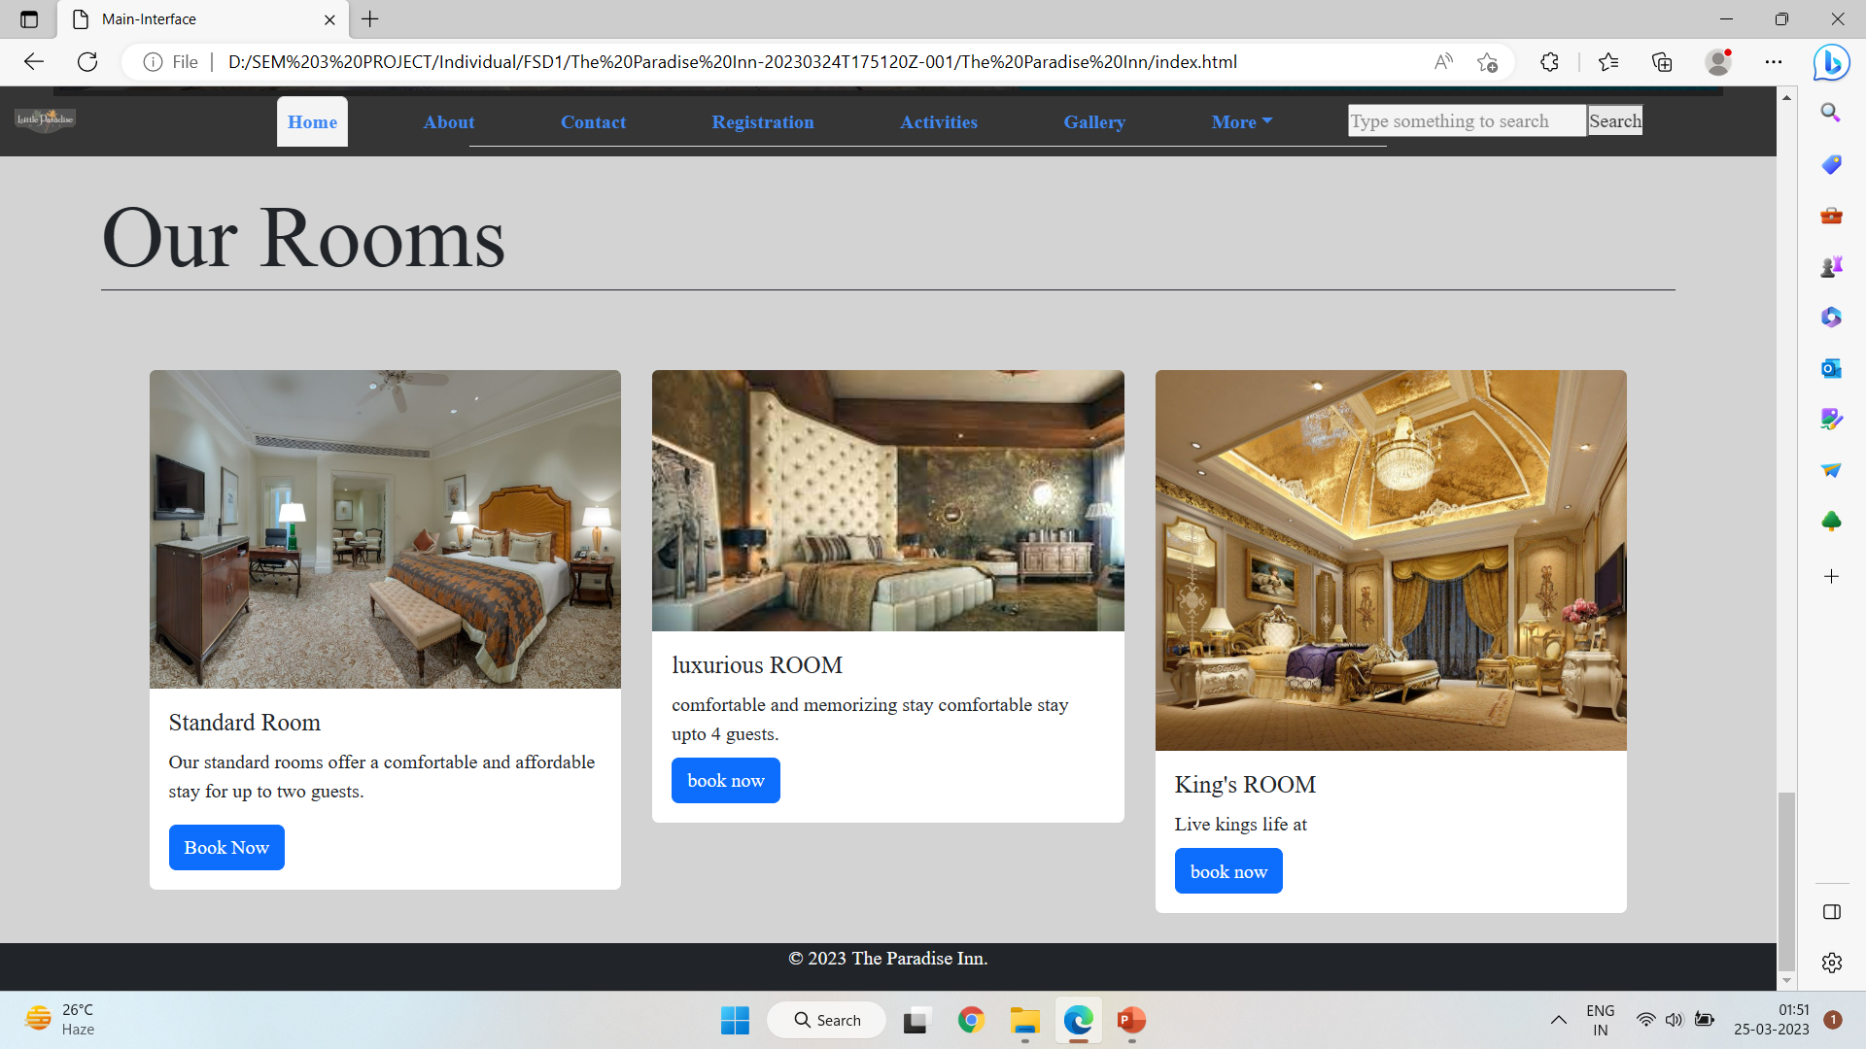
OUR WEBSITE
Website interface will be look like this!

Slide 8

Thank you
Do you have any questions?
TheParadiseInn@gmail.com
+91 123 4567 890
www.theparadiceinn.com

